Slide 1
Literature review
Arun Kumar Rajasekaran

Slide 2
To start with,
It’s actually a hard process of
Formulating the research question(s) and objective(s),
Searching the extant literature,
Screening for inclusion,
Assessing the quality of primary studies,
Extracting data, and
Analyzing data.

Slide 3
Start with research databases
Scopus and Web of Science are good databases to start with for any research topic and literature review.
Scopus Scopus is a large multidisciplinary database covering published material in the humanities and sciences. It also provides citation analysis of authors and subject areas.
Web of Science - Core Collection The leading citation index' of scholarly literature, chemical reactions and author information.

Slide 4
Start with research databases
But there exists a lot more,
PubMed
CINAHL
Web of Science
Embase
Medline
PsycINFO
Scopus
Cochrane Library
Cochrane Central Register of Controlled Trials
https://guides.library.harvard.edu/meta-analysis/databases

Slide 5
For someone absolutely new to database searches
https://app.sidecarlearning.com/tutorials/scopus

Slide 6

Specific databases / Supplementary searches
Discipline / subject oriented

Slide 7
Specific databases / Supplementary searches
2. Grey (gray) literature
Grey literature is research published outside of commercial or academic publishing. Grey literature might not look like a traditional book or article. You may find it in the form of a PDF or report, for example, but the information included should still be high quality.

Slide 8
Gray Literature
Examples of grey literature include:
Government reports
Policy statements and issues papers
Conference proceedings
Pre-prints and post-prints of articles
Theses and dissertations
Research reports
Geological and geophysical surveys
Maps
Newsletters and bulletins
Fact sheets
Who makes grey literature?
Industry bodies
Private companies
Government bodies
Pressure or activist groups
Academics and Higher Degree Research students

Slide 9
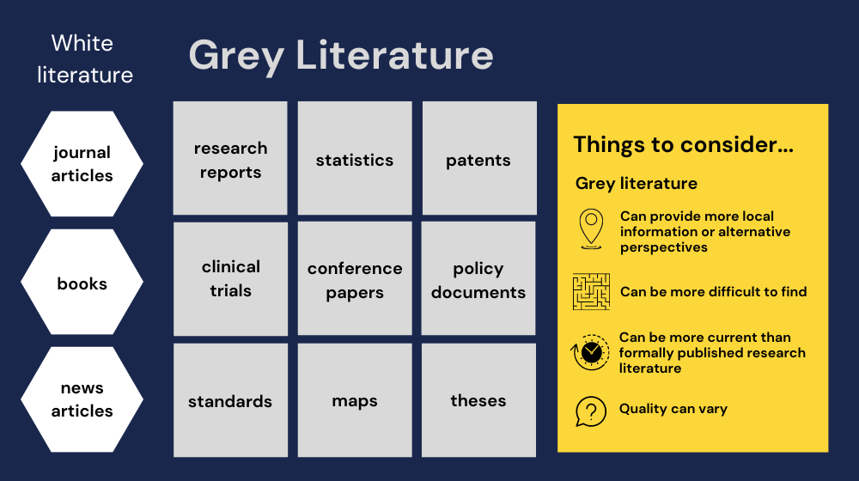
Why use grey literature?
Grey literature is an excellent source of recent research in many disciplines.
Industry and government bodies often produce grey literature and make it available online faster than other publication types.
It's important to check grey literature, like theses and dissertations, to see what research other people are producing in your field.

Slide 10
Finding grey matter
Advanced google searches (say .gov, .edu etc)
Grey source (GrayNet - GreySource provides examples of grey literature to the average net-user and in so doing profiles organizations responsible for its production and/or processing. GreySource identifies the hyperlink directly embedded in a resource, thus allowing immediate and virtual exposure to grey literature.)
GreyMAtters tools (ex. https://cadth-login.wicketcloud.com/login?service=https%3A//www.cadth.ca/casservice%3Fdestination%3D/user/login%253Fdestination%253D%25252Fgrey-matters-practical-tool-searching-health-related-grey-literature)
Institutional repo (ex. IRIS, WHO)

Slide 11
Evaluating literatures (gray/general)
Consider the author, their affiliations and qualifications.
Check reference lists to see who and what other material has been taken into account.
Any data collection methods and analysis should be transparent.
Examine literature reviews in theses to track search strategies and assess possible biases.
Check the date and currency of any information and try to find an update if it is older.
Check the dates of references to make sure the authors aren't relying on out-of-date information.

Slide 12
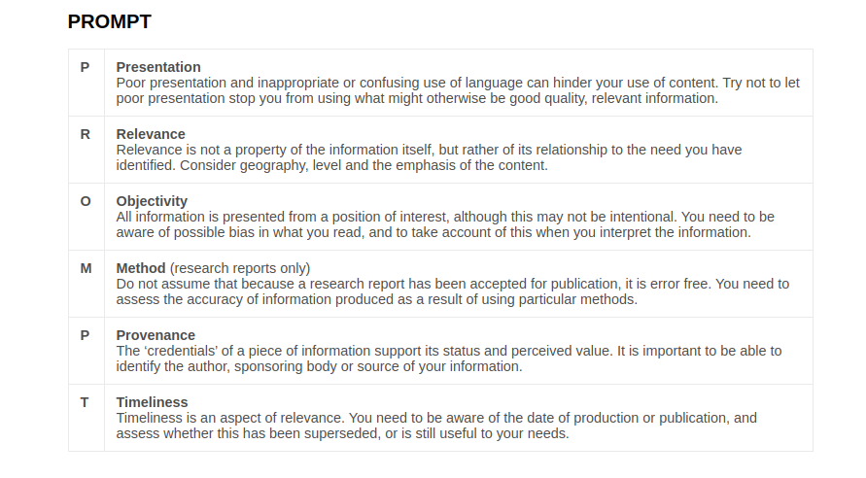

Slide 13
Question

Slide 14
What causes neo mortality ?
Time - 10 mins
Expectations:
5 Major reasons cited
Any uncommon/interesting reasons

Slide 15
Dealing with Anisotropy

Slide 16
Dealing with Anisotropy
Use multiple sources
This means not relying on one database, website, or library, but exploring different options and platforms.
For example, you can use academic search engines, such as Google Scholar, Scopus, or Web of Science, to find peer-reviewed articles and citations.
You can also use subject-specific databases, such as PubMed, PsycINFO, or ERIC, to find literature related to your discipline or topic.
Additionally, you can use library catalogs, reference lists, bibliographies, and citation tracking tools to find books, reports, and other sources.

Slide 17
Dealing with Anisotropy
2. Evaluate your sources
This means checking the quality, credibility, and relevance of the information you find.
You can use various criteria to evaluate your sources, such as the author, the publisher, the date, the purpose, the evidence, and the bias.
You can also use tools such as the CRAAP test or the CARS checklist to help you assess your sources.
Evaluating your sources will help you select the best literature for your research and avoid unreliable or outdated information.

Slide 18
Search tracking
Softwares
Or Excel should do
(Example excel template online)
https://tr.uow.edu.au/uow/file/13fd247b-e4f0-4783-8b50-c7c07685f85b/1/SearchTracker.xlsx
Adapt your search and keep trying
Searching for information is a process and you won't always get it right the first time. Improve your results by changing your search and trying again until you're happy with what you have found.

Slide 19
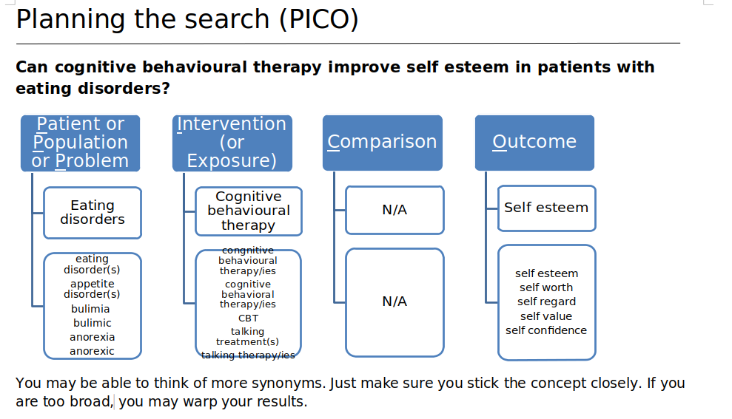
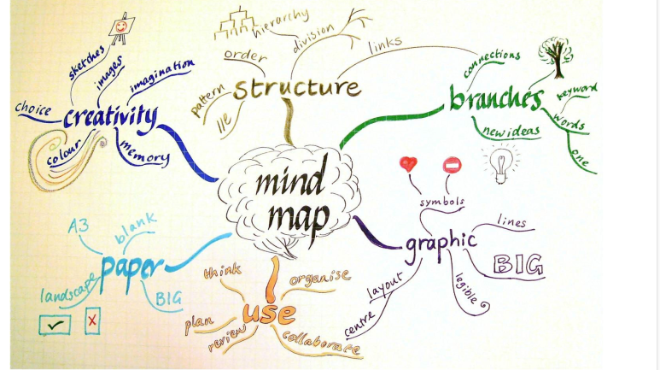
Search tracking
PICO
MIND MAP

Slide 20
Search words
Search for different word endings
Truncation *
The asterisk symbol * will help you search for different word endings.
E.g. teen* will find results with the words: teen, teens, teenager, teenagers
Specific truncation symbols will vary. Check the 'Help' section of the database you are searching.
2. Search for common phrases
Phrase searching “...........”
Double quotation marks help you search for common phrases and make your results more relevant.
E.g. “physical activity” will find results with the words physical activity together as a phrase.

Slide 21
Search words
3. Search for spelling variations within related terms
Wildcards ?
Wildcard symbols allow you to search for spelling variations within the same or related terms.
E.g. wom?n will find results with women OR woman
Specific wild card symbols will vary. Check the 'Help' section of the database you are searching.
4. Search terms within specific ranges of each other
Proximity w/#
Proximity searching allows you to specify where your search terms will appear in relation to each other.
E.g. pain w/10 morphine will search for pain within ten words of morphine
Specific proximity symbols will vary. Check the 'Help' section of the database you are searching.

Slide 22
Organizing literature
Once you have found the best literature for your research, you need to organize it in a systematic and efficient way. This means keeping track of your sources, summarizing and synthesizing them, and creating a reference list.
You can use various tools and methods to organize your literature, such as citation managers, such as Zotero, Mendeley, or EndNote, to store and manage your sources. You can also use software such as NVivo, Atlas.ti, or MAXQDA, to code and analyze your sources. Organizing your literature will help you save time, avoid plagiarism, and prepare for writing your literature review.

Slide 23
Update your literature
Finally, finding the best literature for your research is not a one-time task, but an ongoing process. This means updating your literature regularly and staying on top of new developments and publications in your field of study.
You can use various tools and techniques to update your literature, such as alerts, RSS feeds, newsletters, podcasts, blogs, and social media. Updating your literature will help you keep your research current, relevant, and innovative.

